Slide 1
DR.SNSRCAS, CBE
SUBJECT: CLOUD TECHNOLOGY FUNDAMENTALS
COURSE CODE:21UCA501
TITLE: Authorization markup languages
YEAR: III SEMESTER 2022-2023 (ODD)

Slide 2
Authorization markup languages
Information requests and replies in cloud computing are nearly always in the form of XML replies or requests.
XML files are text files and are self-describing.
That is, XML files contain a schema that
describes the data it contains or contains a
point to another text file with its schema.

Slide 3
Authorization markup languages
A variety of specialized XML files are in the identity framework, the ones of note being XACML and SAML. Service Provisioning Markup Language (SPML)-extensible Access Control Markup Language (XACML).
(XACML) set of policy statements written in XML that support an authentication process.

Slide 4
Authorization markup languages
A policy in XACML describes a subject element that requests an action from a resource.
There are Two Types Point.
Policy Administration Point (PAP).
Policy Decision Point (PDP).
Policy Administration Point (PAP).
The location at which policy is managed is referred to as the Policy Administration Point (PAP).

Slide 5
Authorization markup languages
Policy Decision Point (PDP).
Policy requests are passed through to the location where the policy logic can be executed, referred to as the Policy Decision Point (PDP).
The result of the policy is transmitted through the PAP to the resource that acts on and enforces the PDP policy decision.

Slide 6
Authorization markup languages
The main method for exchanging information between an authentication and authorization service
in a Service Oriented Architecture is the Security
Assertion Markup Language (SAML)
In SAML, a service provider passes a statement or set of statements (called assertions) to an identity provider that must be evaluated.

Slide 7
Authorization markup languages
SAML in most instances operates as a reply/request mechanism.

Slide 8
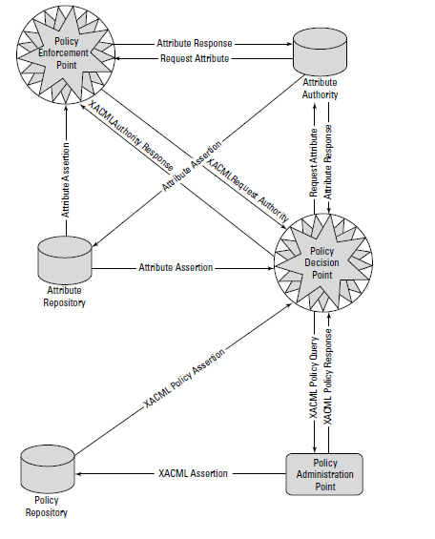
Authorization markup languages

Slide 9
The SAML protocol request is often referred to as a query; the three different supported query types are an authentication query, an attribute query, and an authorization decision query.
SAML requests use a SOAP (simple object access protocol) binding; that is, the SAML request or response is embedded in a SOAP wrapper within an HTTP message.

Slide 10
The SAML protocol request is often referred to as a query; the three different supported query types are an authentication query, an attribute query, and an authorization decision query.
SAML requests use a SOAP (simple object access protocol) binding; that is, the SAML request or response is embedded in a SOAP wrapper within an HTTP message.

Slide 11
SAML is used to provide a mechanism for a Web Browser Single Sign On (SSO).
SAML Single Sign On Request/Response mechanism.
The Service Provisioning Markup Language (SPML) is another of the OASIS open standards developed to provide for service provisioning.

Slide 12
Provisioning is the process by which a resource is prepared for use, reserved, accessed, used, and then released when the transaction is completed.
A classic example of provisioning a resource is the reservation and use of a phone line or a Virtual Private Network.

Slide 13
provisioning system has three types of components:
Requesting Authority (RA)
Provisioning Service Point (PSP)
Provisioning Service Targets (PST)
1. Requesting Authority (RA)
Requesting Authority (RA) is the client

Slide 14
2.Provisioning Service Point (PSP)
cloud component that receives the request and returns a response.
3. Provisioning Service Targets (PST)
software application upon which the provisioning action is performed

Slide 15
SPML is used to prepare Web services and applications for use.

Slide 16
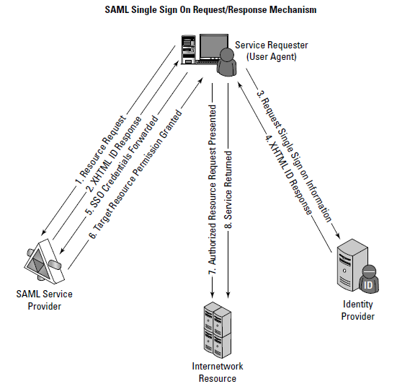

Slide 17
Thank You

